Slide 1
Amazon - Clone - WebSite
Meet the Team :
Khaled Hany – Frontend Developer
Mohamed Ibrahim – Frontend Developer
Youssef Hatem – Backend Integration & Firebase
Faris abdelbagi – Product Management & Testing
Ahmed alazzbaawy – API Integration & Redux Management

Slide 2
Experiment Teamwork
Working with the team helped me learn how to communicate better and listen to others' opinions.
We divided the tasks between us, and everyone had a clear role — we supported each other the whole time.
We faced many challenges, but teamwork was what helped us overcome them.
This experience made a big difference for me and made me love the idea of succeeding as a team, not as individuals.
I also learned how to take responsibility for my part and deliver my work on time.
I realized how fun and meaningful teamwork can be when everyone gives it their all.

Slide 3
🛍 Project Idea and Type of e-Commerce We Worked On
The project is a simplified version of the Amazon website, offering an online shopping experience that includes login, product browsing, adding items to the cart, placing orders, and making payments, etc.
The type of e-Commerce we worked on is B2C (Business to Customer), where the platform directly serves customers to purchase products online.
🎯 Target Users
We targeted everyday users who enjoy shopping online with ease and speed, without complications.
Our focus was on delivering a clean, fast, and responsive user interface across all devices (mobile – tablet – laptop).
The main age group we aimed for was between 18 and 40 years old

Slide 4
🛠 Technologies Used
React - For building a dynamic and interactive UI.
Redux Toolkit - For centralized and organized state management.
Firebase - For authentication, database storage, and order management.
Tailwind CSS - For fast and modern UI styling.
React Router - For smooth and simple page navigation.
Formik + Yup - For form handling and validation.
Axios - For communicating with APIs (CRUD operations).
React Toastify, Spinners & Icons - For better user experience with notifications, loading indicators, and intuitive icons

Slide 5
Project Demo
Main Pages Overview :
Home Page : Displays products attractively with filtering options by category or brand.
Login / Register Page: Allows users to create a new account or log into an existing one.
Product Page : Shows detailed information about the product, including price, reviews, and buttons to add to cart or wishlist.
Cart Page: Lets users review selected items before checkout, modify quantity, or remove products.
Checkout Page : A form to enter shipping information and select the payment method.
Orders Page : Enables users to view their previous orders and their statuses (In Progress – Delivered)

Slide 6
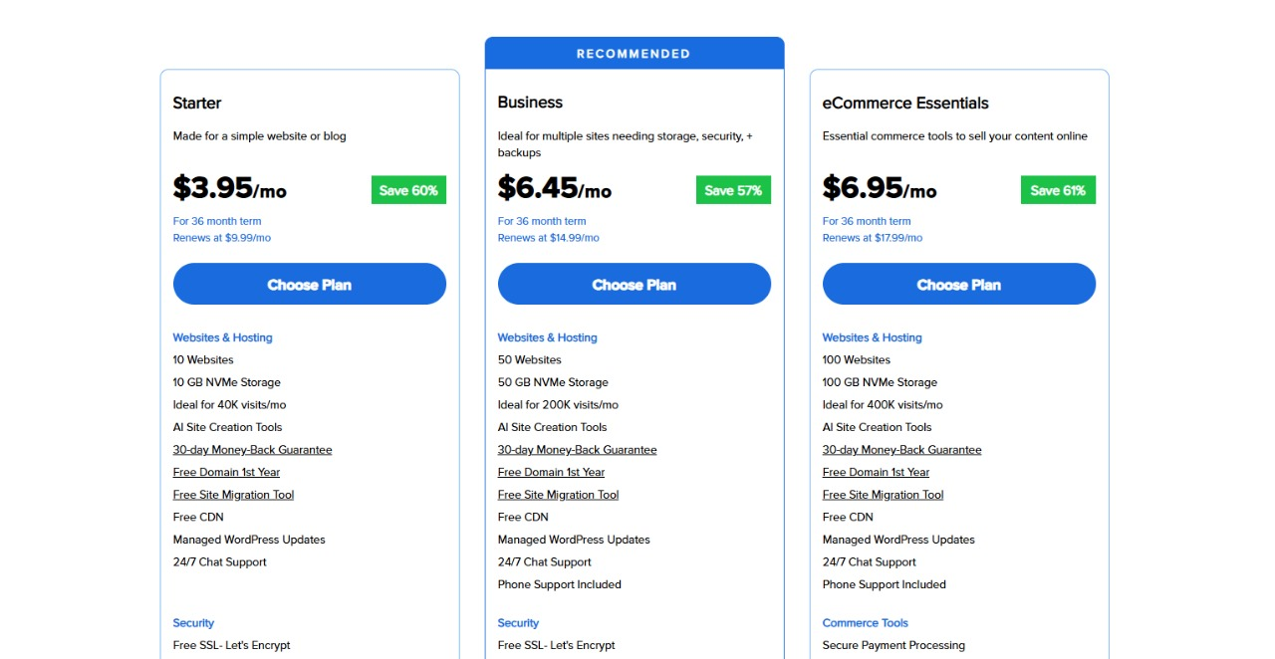

Slide 7
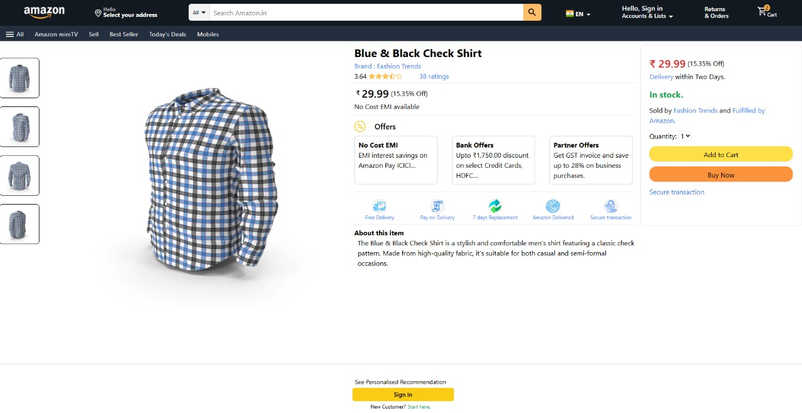

Slide 8
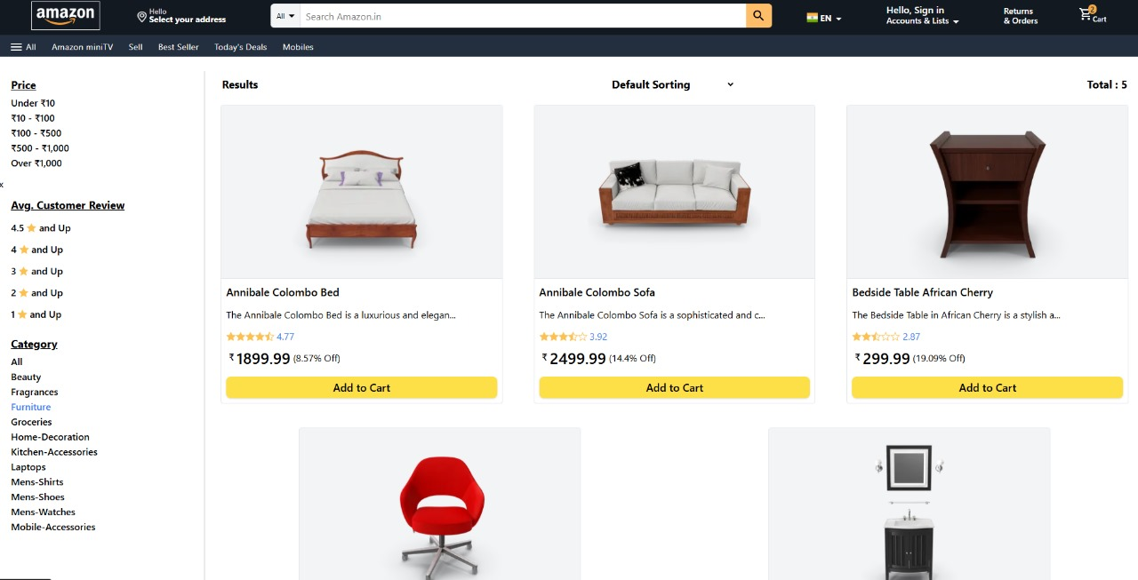

Slide 9
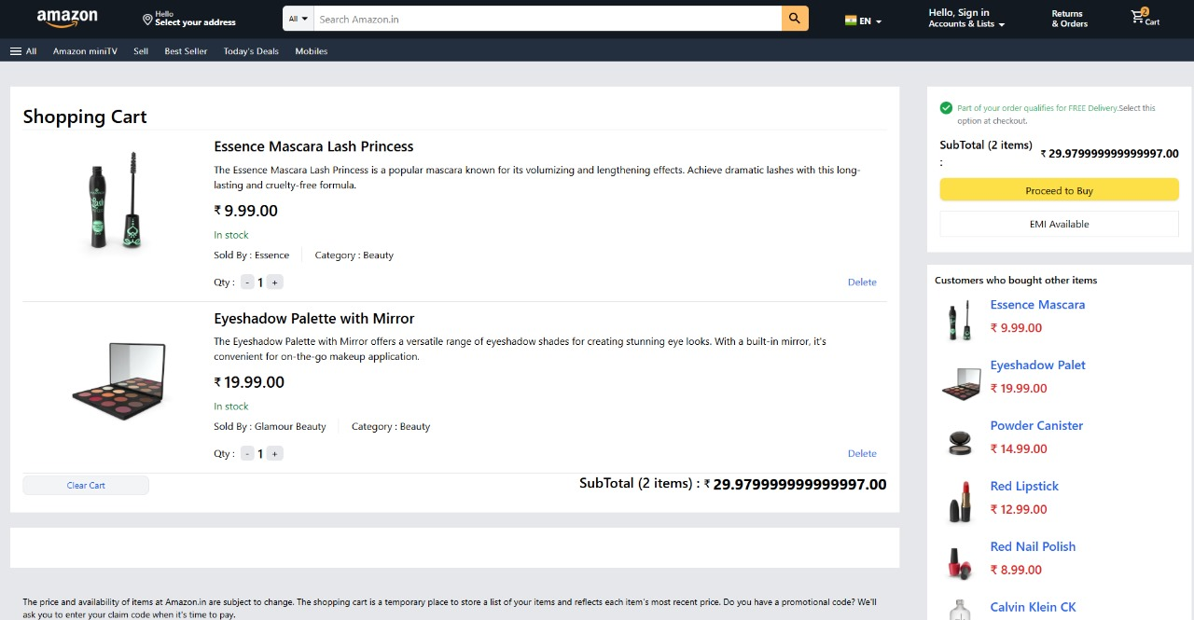

Slide 10
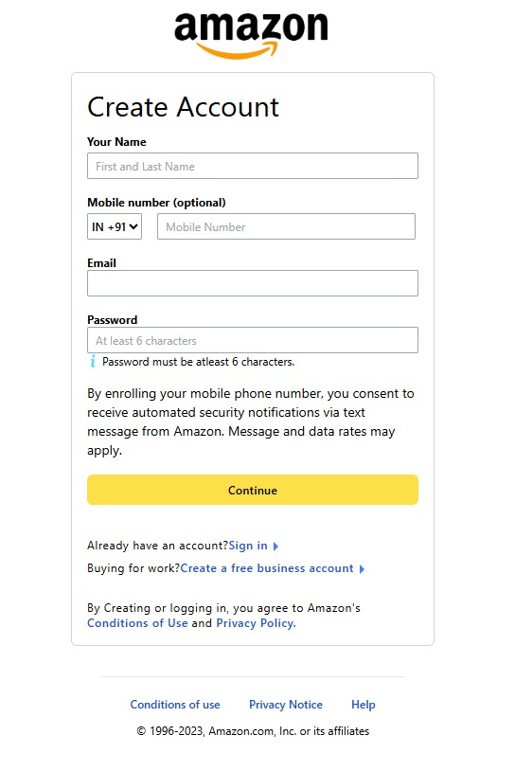
Registration - PAge

Slide 11
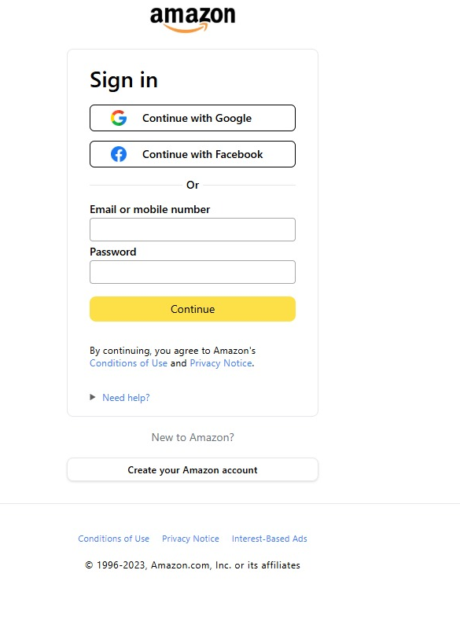
Login - Page

Slide 12
Key Features Implemented:
Secure Login using Firebase Authentication.
Comprehensive Cart & Wishlist Management with Redux Toolkit.
Fully Responsive Design that works seamlessly on mobile and tablet devices.
Real Order System with data stored and managed in Firebase.
Interactive Notifications using React Toastify.
High Performance powered by React and Tailwind CSS.

Slide 13
Challenges We Faced & How We Solved Them:
File Organization & Component Overload:
At first, the project became messy due to the large number of files and components.
✅ We implemented a clear folder structure and followed a modular development approach to keep things organized.
Working with Firebase Authentication for the First Time:
Understanding the login flow and session management was a bit tricky.
✅ We carefully read the official Firebase docs and implemented the flow step by step after fully understanding it.
Responsive Design Issues on Small Screens:
Some pages didn’t display well on mobile or tablet screens.
✅ We fixed that using Tailwind’s responsive breakpoints and tested the layout on multiple screen sizes.
Data Duplication & State Management Problems:
Some data was being duplicated or not updating correctly.
✅ We used Redux Toolkit in a clean, organized way by creating separate slices for each data domain.

Slide 14
Future Steps & Planned Enhancements
We already have ideas to take this project to the next level:
Implement a Ratings & Reviews System to allow users to share feedback and rate products.
Integrate Real Payment Gateways like Stripe or PayPal instead of the current dummy payment flow.
Enhance User Experience with advanced filtering options and faster page loading.
Develop an Admin Dashboard to manage products, orders, and user activity efficiently

Slide 15
💡 Key Takeaways & Reflections
Good Planning & Structure at the beginning is essential for building any successful project.
Teamwork Made a Huge Difference — it accelerated our progress and allowed knowledge-sharing across the team.
A Very Practical Learning Experience — we faced real development challenges and learned how to solve them hands-on.
Everyone on the Team Improved noticeably in both technical and collaboration skills — the journey was productive and fun!

